Slide 1

Stock Market Price Prediction Using Machine Learning Mini Project KCS 752/ 7th Sem
STUDENT NAME :
Anurag Bhardwaj
[2000320120039]

Slide 2
Outline
Dataset selection
Importing Libraries and Datasets
Data Pre-processing
Data Visualization
Splitting Dataset
Model Training and Evaluation
Visualization of Results
Future outcomes

Slide 3
Introduction
A stock market, equity market, or share market is the aggregation of buyers and sellers of stocks (also called shares), which represent ownership claims on businesses; these may include securities listed on a public stock exchange, as well as stock that is only traded privately, such as shares of private companies which are sold to investors through equity crowdfunding platforms. Investment is usually made with an investment strategy in mind..
It is a place where the opportunity to make money is immense. However, it requires immense skill to generate money from the market.

Slide 4
Proposed System
1. Data Collection and Storage:
Selection of dataset by analyzing parameters.
Create a secure and organized data repository.
2. Data Analysis and Visualization:
Use statistical software for analysis and visualization.
Calculate statistics, correlations, and, if applicable, perform hypothesis testing and inferential analysis.
Create clear data visualizations to illustrate findings.
3. Project Report and Documentation:
Prepare a structured project report with sections covering introduction, methodology, findings, discussion, and conclusion.
Maintain documentation for transparency and reproducibility.
4. Ethical and Security Considerations:
Adhere to ethical guidelines for data collection and analysis, particularly when working with sensitive student data.
Implement data security measures to protect sensitive information

Slide 5
Objectives
Prediction of the future prices of the stocks listed in the stock market.
It tells whether or not the stocks can be upscaled in the future scenario according to the time.

Slide 6
Tools and Technologies Used
Python
Matplotlib, Pandas and Seaborn (Python)
Excel
SQL
GitHub
Jupyter Notebooks
Visual Studio Code
Additional Libraries

Slide 7
Methodology Used
As this is a classification problem so we will be using these models :
K Neighbor Classifiers
Random Forest Classifiers
Support Vector Classifiers
Logistic Regressions
To predict the accuracy we will use the accuracy score function from scikit-learn library.

Slide 8
Regression and Classification algorithms are Supervised Learning algorithms. Both the algorithms are used for prediction in Machine learning and work with the labeled datasets. The main difference between Regression and Classification algorithms that Regression algorithms are used to predict the continuous values such as price, salary, age, etc. and Classification algorithms are used to predict/Classify the discrete values such as Male or Female, True or False, Spam or Not Spam, etc.

Slide 9
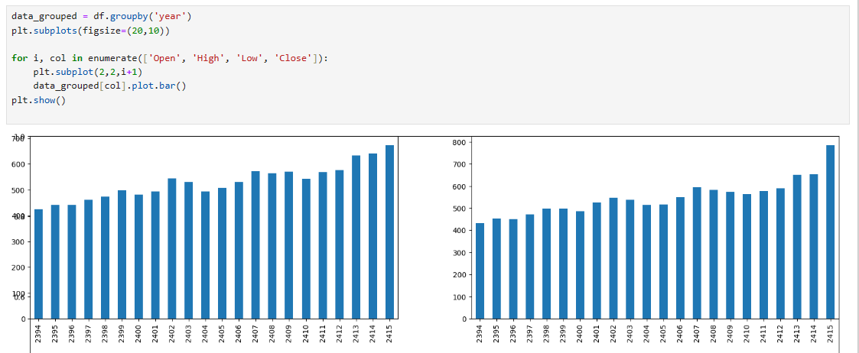
Implementation

Slide 10
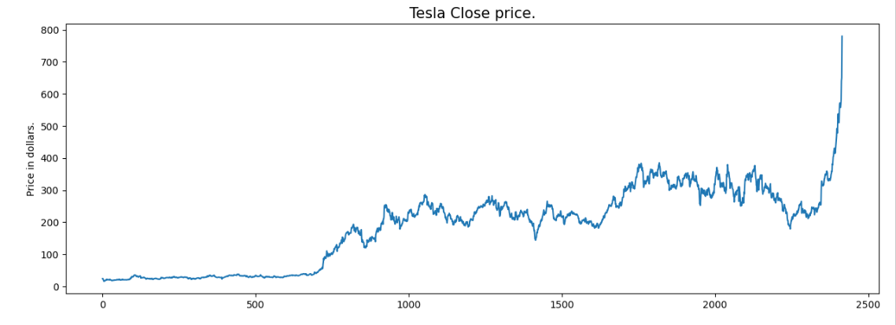
Implementation

Slide 11
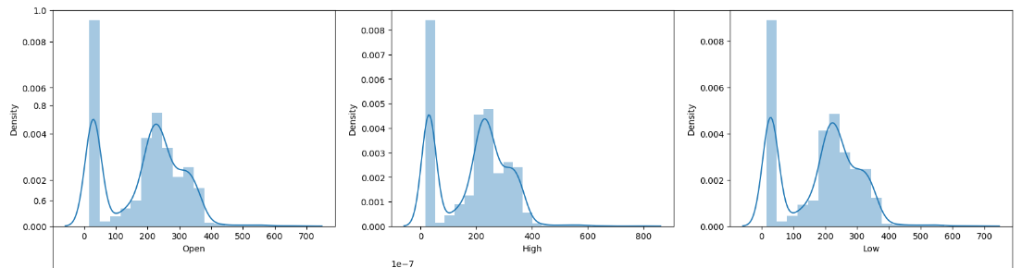
Implementation

Slide 12
Limitations &Future Enhancements
Limitations: This project's limitations include single dataset which can be treated by increasing number of data fields in the dataset taken.
Future Enhancements: To improve the project, we can also consider increasing the number of dataset and combining these data sets into one by various mathematical operations. We can also consider to choose different classification algorithms for better accuracy.

Slide 13
Conclusion
Random Forest Classifier is giving the best accuracy with an accuracy score of 82% for the testing dataset. And to get much better results ensemble learning techniques like Bagging and Boosting can also be used.

Slide 14
References
Johnston, L. D., O'Malley, P. M., Bachman, J. G., Schulenberg, J. E., & Miech, R. A. (2020). "Monitoring the Future national survey results on drug use, 1975-2019: Volume II, College students and adults ages 19-60." Institute for Social Research, The University of Michigan.
National Institute of reserach and Alcoholism (NIAAA). (2015). "College drinking.
Read, J. P., Merrill, J. E., Kahler, C. W., & Strong, D. R. (2007). "Predicting functional outcomes among college drinkers: Reliability and predictive validity of the Young Adult Alcohol Consequences Questionnaire." Addictive Behaviors, 32(11), 2597-2610.

Slide 15
THANK YOU

